Slide 1
CHAPTER 1:
A Preview of Business Statistics
to accompany
Introduction to Business Statistics
seventh edition, by Ronald M. Weiers
Presentation by Priscilla Chaffe-Stengel
Donald N. Stengel
© 2011 Cengage Learning.
All Rights Reserved. May not be scanned, copied, or duplicated, or posted to a publicly accessible website, in whole or in part.

Slide 2
Chapter 1 - Key Terms
Collection, summarization, analysis, and reporting of numerical findings
Statistics - Two Usages
  A. The study of statistics
  B. Statistics as reported sample measures
    1. Descriptive
    2. Inferential
© 2011 Cengage Learning.
All Rights Reserved. May not be scanned, copied, or duplicated, or posted to a publicly accessible website, in whole or in part.

Slide 3
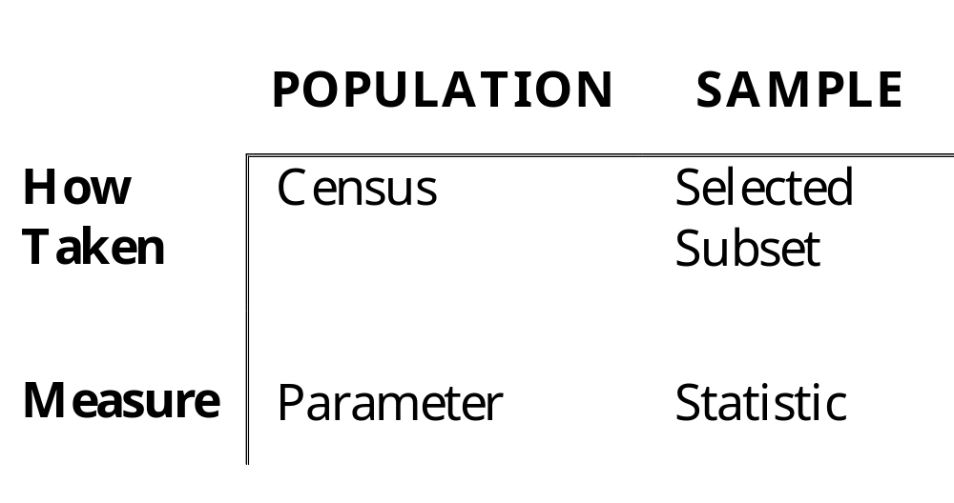
Chapter 1 - Key Terms
Inferential Statistics
© 2011 Cengage Learning.
All Rights Reserved. May not be scanned, copied, or duplicated, or posted to a publicly accessible website, in whole or in part.

Slide 4
Types of Variables
Qualitative Variables
  Attributes, categories
    Examples: male/female, registered to vote/not, ethnicity, eye color....
Quantitative Variables
  Discrete - usually take on integer values but can take on fractions when variable allows - counts, how many
  Continuous - can take on any value at any point along an interval - measurements, how much
© 2011 Cengage Learning.
All Rights Reserved. May not be scanned, copied, or duplicated, or posted to a publicly accessible website, in whole or in part.

Slide 5
Example: Types of Variables
Problem 1.16
For each of the following, indicate whether the appropriate variable would be qualitative or quantitative. If the variable is quantitative, indicate whether it would be discrete or continuous.
© 2011 Cengage Learning.
All Rights Reserved. May not be scanned, copied, or duplicated, or posted to a publicly accessible website, in whole or in part.

Slide 6
Problem 1.16
a) Whether you own a Panasonic television set
b) Your status as a full-time or a part-time student
c) Number of people who attended your school’s graduation last year
Qualitative Variable
  two levels: yes/no
  no measurement
Qualitative Variable
  two levels: full/part
  no measurement
Quantitative, Discrete Variable
  a countable number
  only whole numbers
© 2011 Cengage Learning.
All Rights Reserved. May not be scanned, copied, or duplicated, or posted to a publicly accessible website, in whole or in part.

Slide 7
Problem 1.16, continued
d) The price of your most recent haircut
e) Sam’s travel time from his dorm to the student union
Quantitative, Discrete Variable
  a countable number
  only whole numbers
Quantitative, Continuous Variable
  any number
  time is measured
  can take on any value greater than zero
© 2011 Cengage Learning.
All Rights Reserved. May not be scanned, copied, or duplicated, or posted to a publicly accessible website, in whole or in part.

Slide 8
Problem 1.16, continued
f) The number of students on campus who belong to a social fraternity or sorority
Quantitative, Discrete Variable
  a countable number
  only whole numbers
© 2011 Cengage Learning.
All Rights Reserved. May not be scanned, copied, or duplicated, or posted to a publicly accessible website, in whole or in part.

Slide 9
Scales of Measurement
Nominal Scale - Labels represent various levels of a categorical variable.
Ordinal Scale - Labels represent an order that indicates either preference or ranking.
Interval Scale - Numerical labels indicate order and distance between elements. There is no absolute zero and multiples of measures are not meaningful.
Ratio Scale - Numerical labels indicate order and distance between elements. There is an absolute zero and multiples of measures are meaningful.
© 2011 Cengage Learning.
All Rights Reserved. May not be scanned, copied, or duplicated, or posted to a publicly accessible website, in whole or in part.

Slide 10
Example: Scales of Measurement
Problem 1.20
Bill scored 1200 on the Scholastic Aptitude Test and entered college as a physics major. As a freshman, he changed to business because he thought it was more interesting. Because he made the dean’s list last semester, his parents gave him $30 to buy a new Casio calculator. Identify at least one piece of information in the:
© 2011 Cengage Learning.
All Rights Reserved. May not be scanned, copied, or duplicated, or posted to a publicly accessible website, in whole or in part.

Slide 11
Problem 1.20, continued
a) nominal scale of measurement.
1. Bill is going to college.
2. Bill will buy a Casio
calculator.
3. Bill was a physics major.
4. Bill is a business major.
5. Bill was on the dean’s list.
© 2011 Cengage Learning.
All Rights Reserved. May not be scanned, copied, or duplicated, or posted to a publicly accessible website, in whole or in part.

Slide 12
Problem 1.20, continued
b) ordinal scale of measurement
c) interval scale of measurement
d) ratio scale of measurement
Bill is a freshman.
Bill earned a 1200 on the SAT.
Bill’s parents gave him $30.
© 2011 Cengage Learning.
All Rights Reserved. May not be scanned, copied, or duplicated, or posted to a publicly accessible website, in whole or in part.

